Slide 1
EMOTION RECOGNITION SYSTEM
AND ITS IMPLEMENTATION IN CAR SAFETY FEATURES.

Slide 2
Made By:
AKSHIT JAIN 20BCE1818
HARNUR SINGH 20BCE1809
AKASH RAJ BEHERA 20BCE1829

Slide 3
CONTENTS :
Introduction
Problem Statement
Motivation
Abstract

Slide 4
Introduction
A field of Artificial Intelligence that aims to recognize and interpret human emotions and feelings through various means such as facial expressions, voice, gestures, and body language.

Slide 5
Problem Statement
Despite the significant advancements in AI and computer vision, accurately recognizing human emotions is still a challenging task. There is a lack of robust and reliable systems that can recognize emotions in real-time and in diverse scenarios.

Slide 6
Motivation
Improved Customer Experience
Improved User Experience
Mental health Assessment
Marketing and advertising
Security and surveillance

Slide 7
ABSTRACT
Data Collection: A large amount of data is collected, including images, videos, or audio recordings of individuals expressing different emotions. This data is then labeled based on the emotions being expressed.
Feature Extraction: Features are extracted from the collected data that are relevant to the emotions being expressed. For example, features such as facial expressions, lip movements, or tone of voice can be used to identify emotions in images, videos, or audio recordings.
Model Training: A machine learning model is trained using the labeled data and extracted features. The model is designed to recognize patterns in the data that are indicative of specific emotions.
Emotion Classification: The trained model is then used to classify new data into different emotions. The output of the model is a set of probabilities, indicating the likelihood that a given emotion is being expressed.
Output: The results of the emotion classification are presented in a visual or graphical form, making it easy to understand and interpret the emotions being expressed.

Slide 8
LITERATURE SURVEY
Facial expression-based automatic emotion recognition is an intriguing study area that has been presented and used in a number of fields, including safety, health, and human-machine interactions. Researchers in this discipline are interested in creating methods to decipher, encode, and extract these characteristics from facial expressions in order to improve computer prediction. Deep learning has been remarkably successful, and its various architectures are now being used to improve performance. This paper's goal is to do an analysis of recent work on FER (automatic facial emotion recognition) using deep learning. By contrasting the suggested techniques with the actual results, it highlight the contributions that have been processed, the architecture, and the databases that have been employed.

Slide 9
PROPOSED ARCHITECTURE
The proposed system is an emotion recognition system that uses Convolutional Neural Networks (CNN) and OpenCV for detecting and categorizing human emotions from facial expressions in real-time. The system has three stages: face detection, identification of facial landmarks, and emotion recognition. The Haar Cascade classifier and pre-trained Facial Landmark Detection model are used for face detection and facial landmark identification. The pre-trained CNN model is used for emotion recognition, and the output includes the label for the recognized emotion and its confidence score. The system can be used for various applications, such as improving lighting in a space or tailoring marketing campaigns based on the identified emotion.

Slide 10
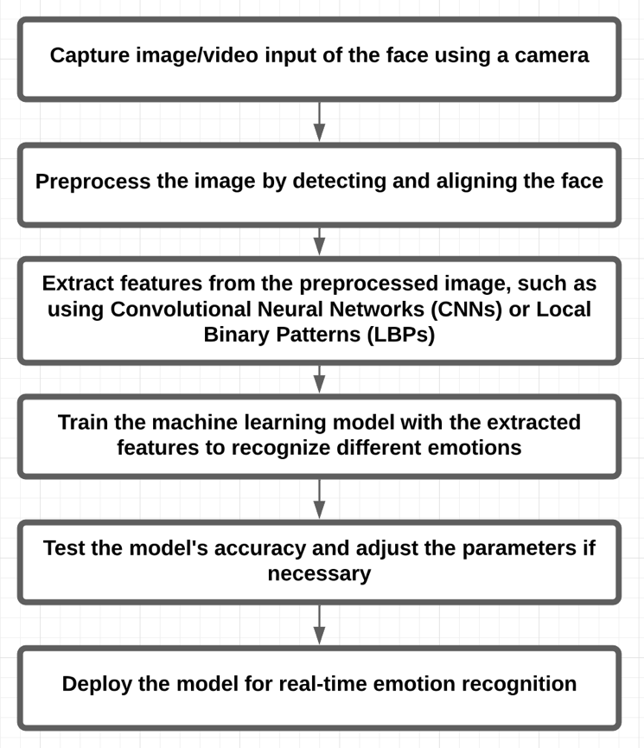
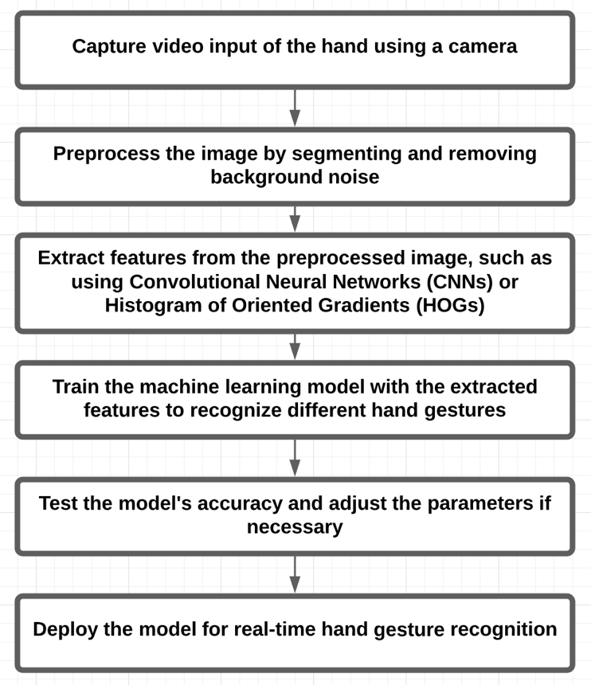
Architecture
Module 1 (DRIVER’S FACIAL RECOGNITION)
Module 2(PASSENGER’S SIDE HAND GESTURE)

Slide 11
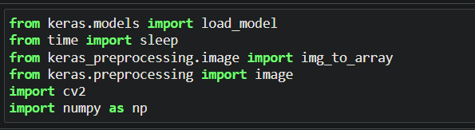
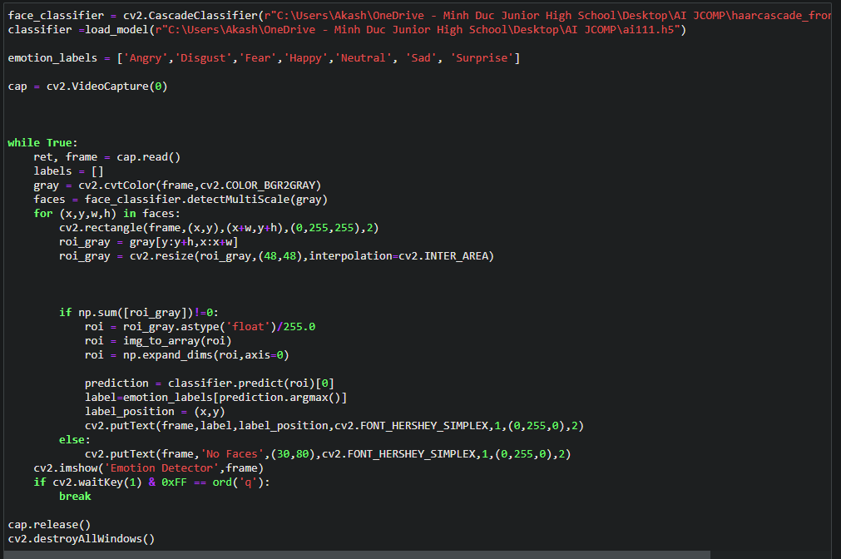
MODULE 1 CODE SNIPPET

Slide 12
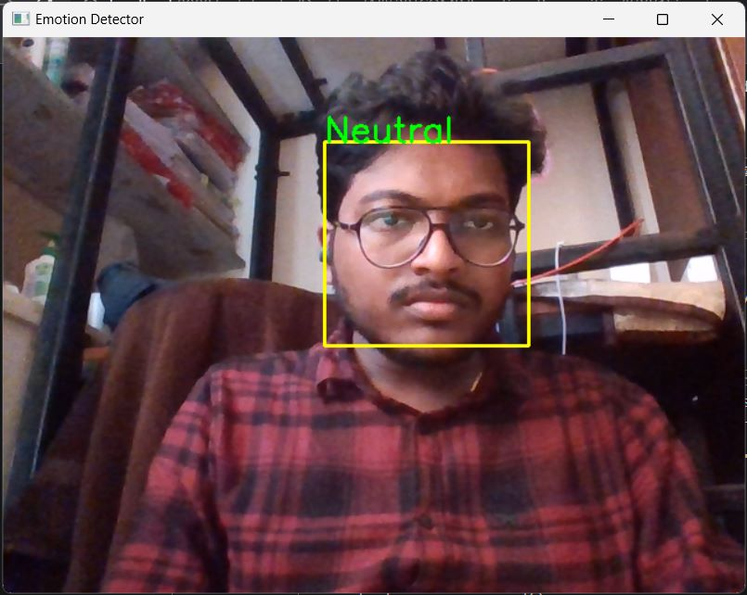
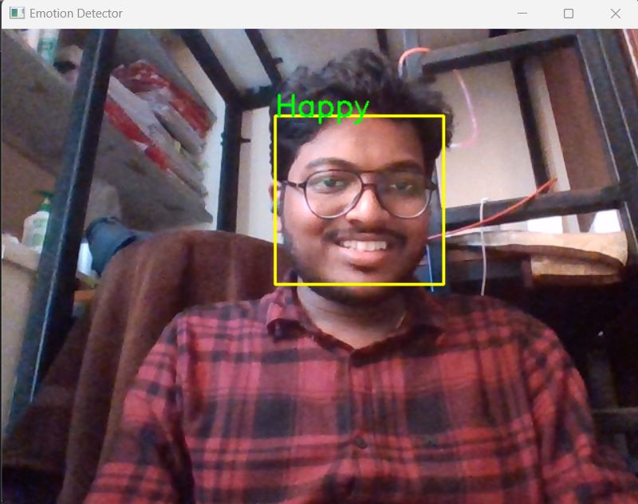
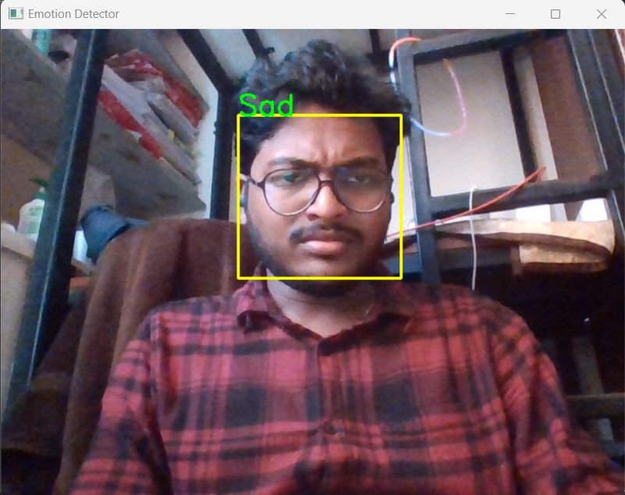
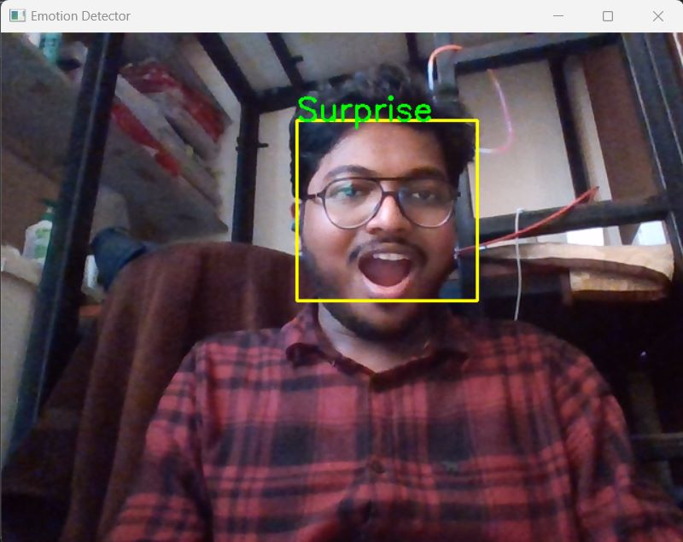
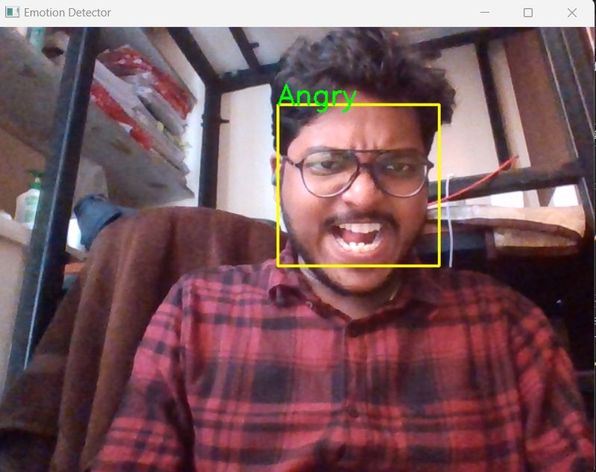
MODULE 1 OUTPUT

Slide 13
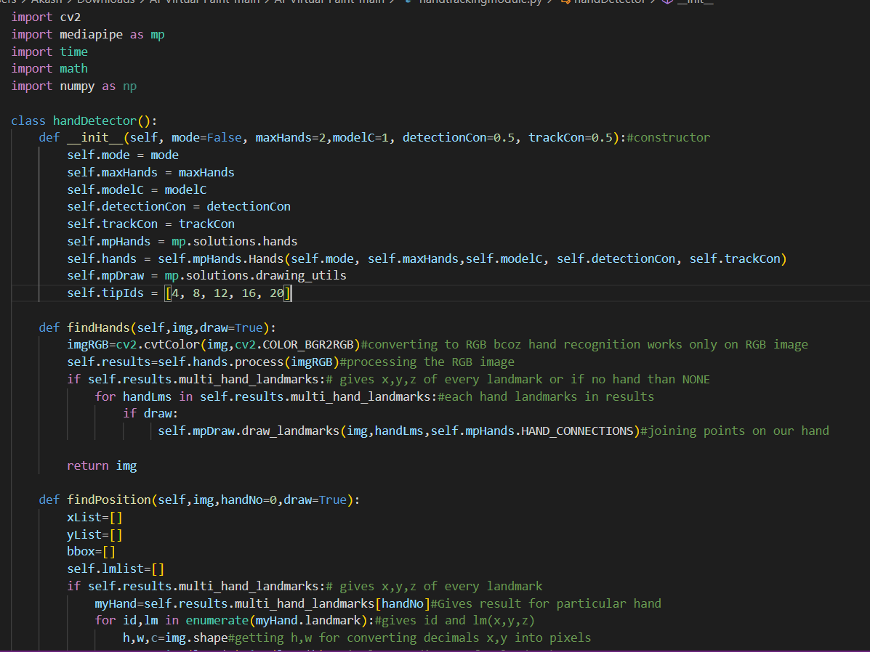
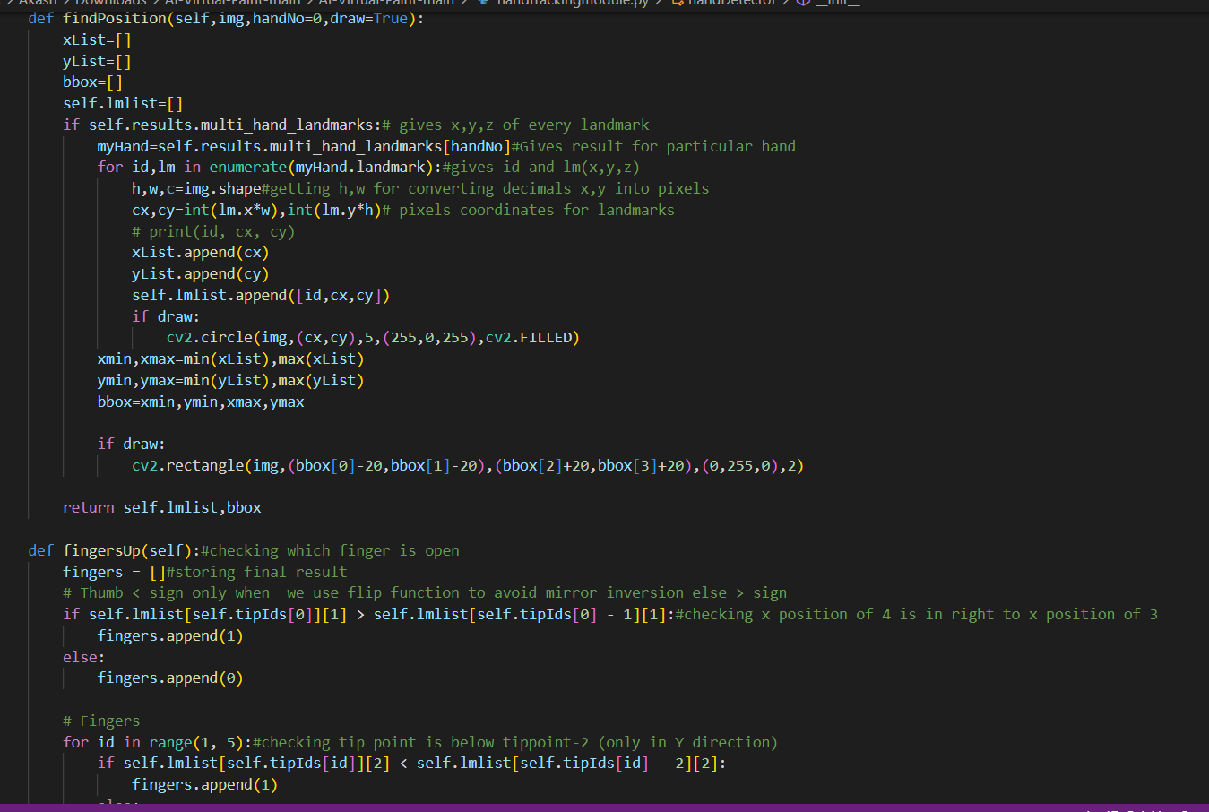
MODULE 2 CODE SNIPPET

Slide 14
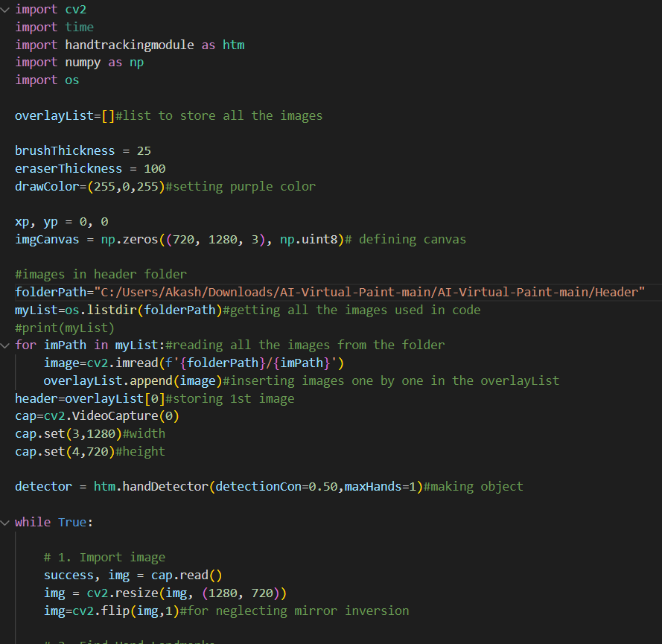
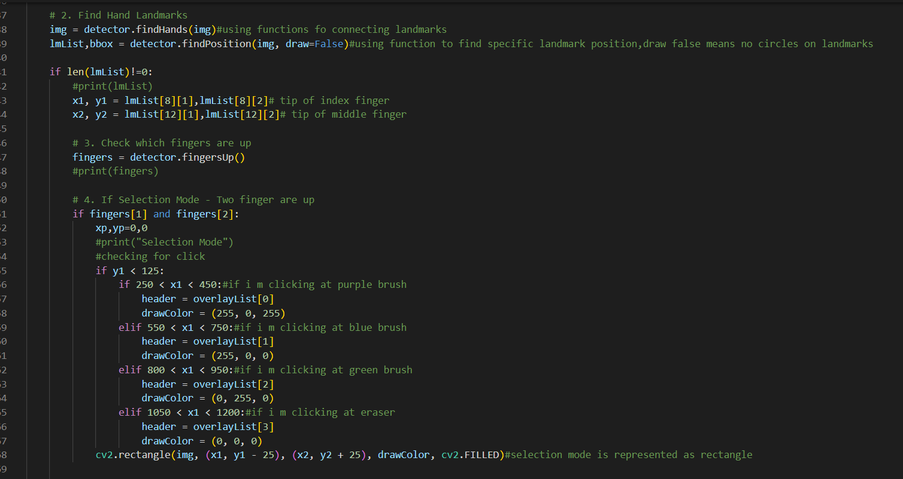
MODULE 2 CODE SNIPPET

Slide 15




MODULE 2 OUTPUT

Slide 16

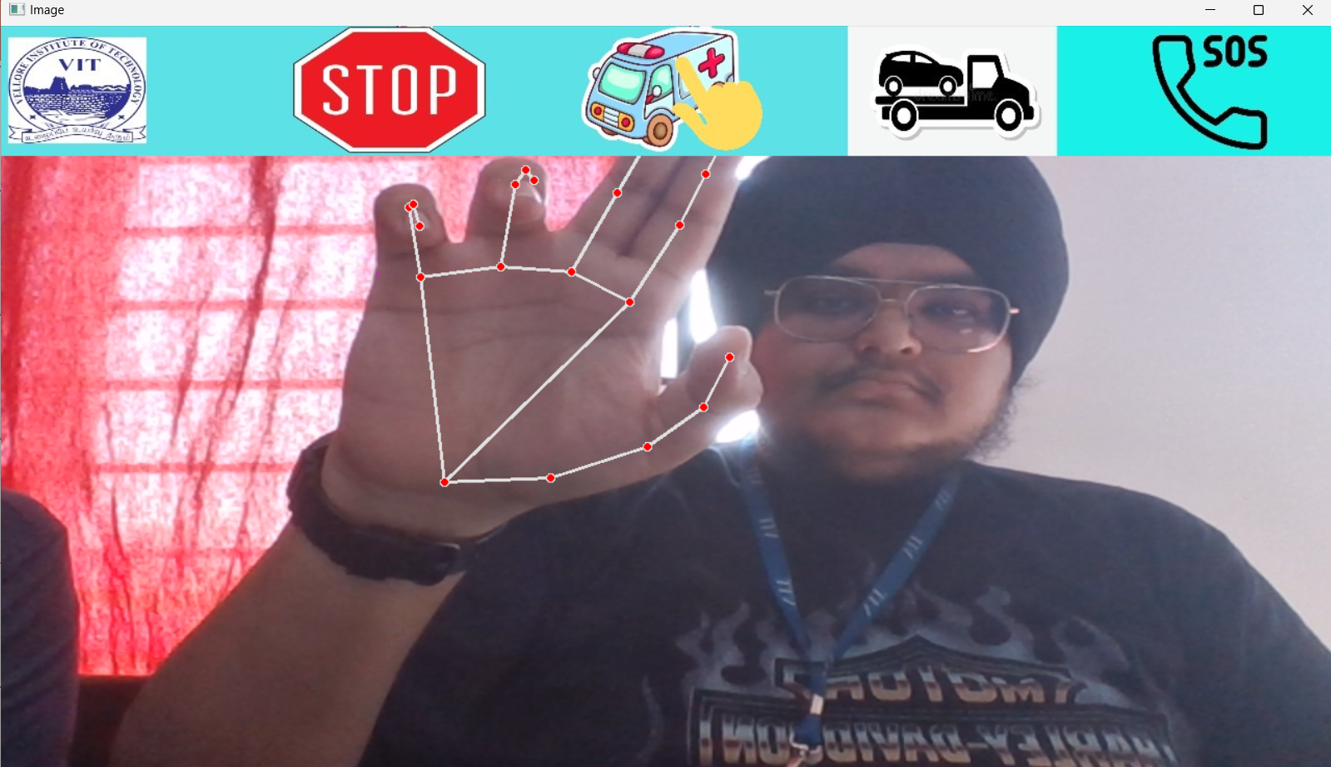
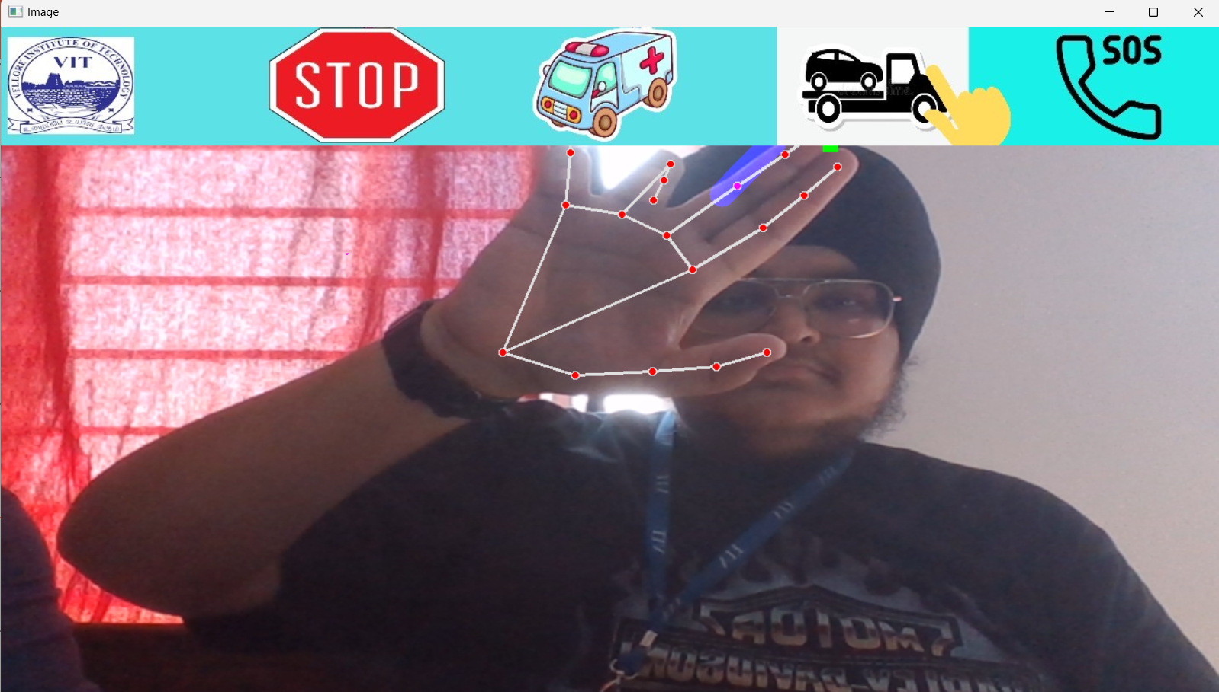

MODULE 2 OUTPUT

Slide 17
THANK YOU!

